Slide 1
Team Skill 1: Analyzing the Problem

Slide 2
Development teams tend to forge ahead, providing solutions based on an inadequate understanding of the problem to be solved.

Slide 3
Problem analysis is the process of understanding real-world problems and user's needs and proposing solutions to meet those needs.
The goal of problem analysis is to gain a better understanding of the problem being solved, before development begins.
To identify the root cause, or the problem behind the problem, ask the people directly involved.
Identifying the actors on the system is a key step in problem analysis.

Slide 4
a problem can be defined as the difference between things as perceived and things as desired.
Sometimes, the simplest solution is a workaround, or revised business process, rather than a new system.

Slide 5
The Five Steps in Problem Analysis
1. Gain agreement on the problem definition.
2. Understand the root causes—the problem behind the problem.
3. Identify the stakeholders and the users.
4. Define the solution system boundary.
5. Identify the constraints to be imposed on the solution.

Slide 6
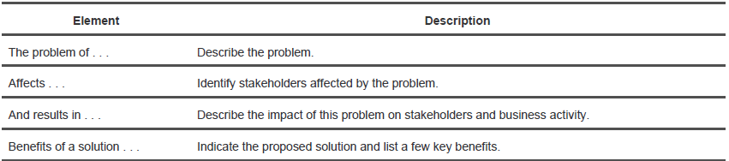
Step 1: Gain Agreement on the Problem Definition
The Problem Statement

Slide 7
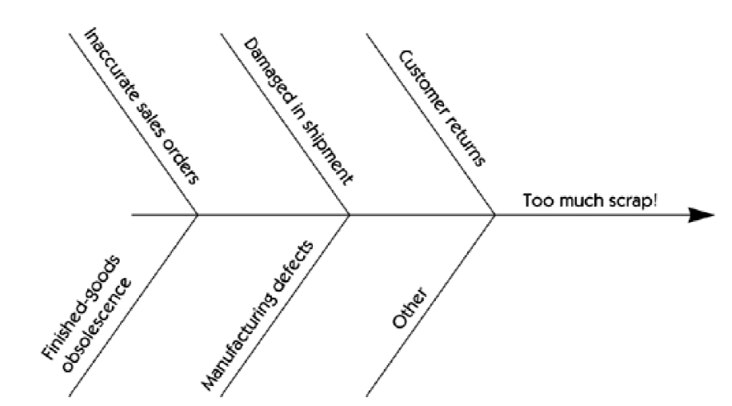
Step 2: Understand the Root Causes—The Problem Behind the Problem
Fishbone diagram of root causes

Slide 8
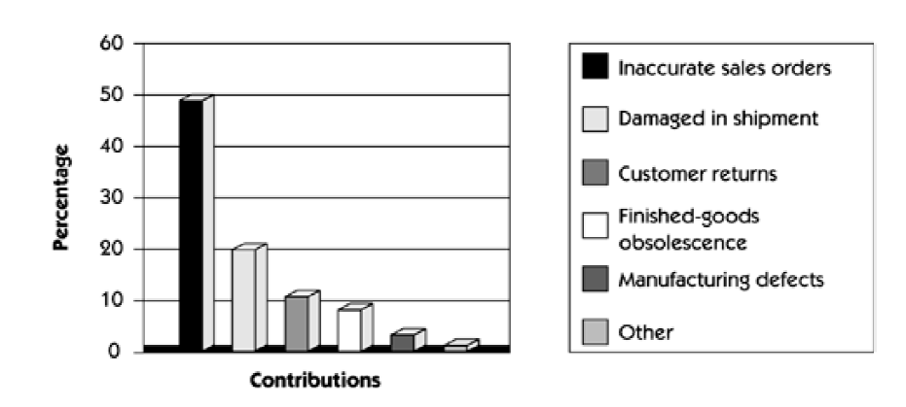
Quality data demonstrates that many root causes are simply not worth fixing.
Pareto chart of root causes

Slide 9
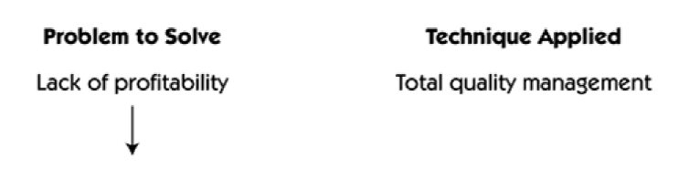
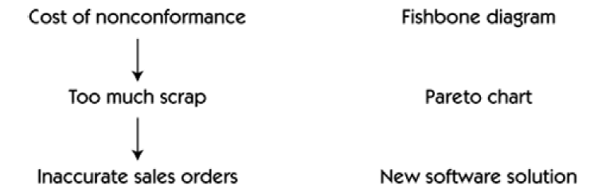
Applying different problem analysis techniques as a problem unfolds

Slide 10
Step 3: Identify the Stakeholders and the Users
anyone who could be materially affected by the implementation of a new system or application.
Nonuser stakeholder needs must also be identified and addressed.
people and organizations involved in the development of the system, the subcontractors, the customer's customer, and outside agencies

Slide 11
Identifying the stakeholders
Questions:
Who are the users of the system?
Who is the customer (economic buyer) for the system?
Who else will be affected by the outputs the system produces?
Who will evaluate and approve the system when it is delivered and deployed?
Are there any other internal or external users of the system whose needs must be addressed?
Who will maintain the new system?
Is there anyone else who cares?

Slide 12
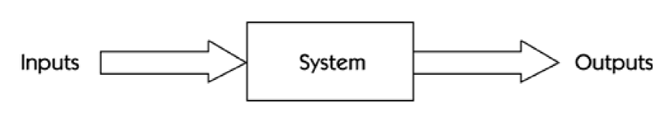
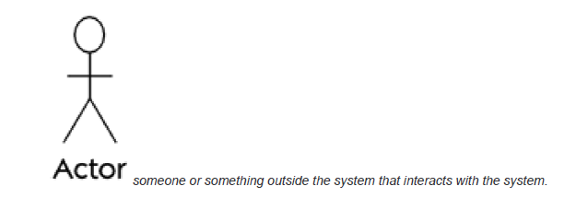
Step 4: Define the Solution System Boundary
We divide the world in two:
1. Our system
2. Things that interact with our system

Slide 13
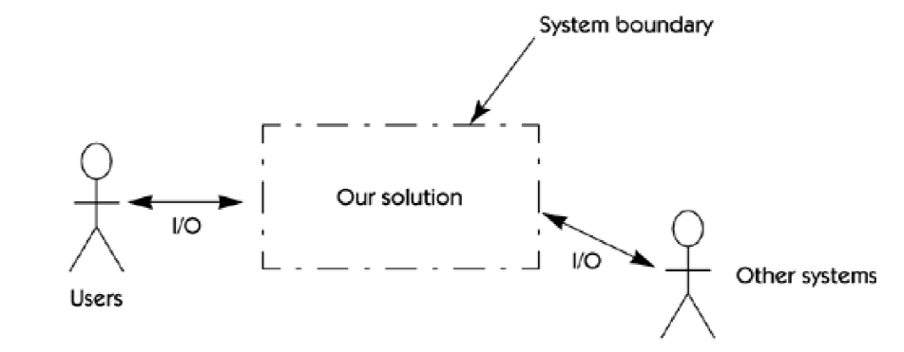
System boundary

Slide 14
Identifying the actors
Questions:
Who will supply, use, or remove information from the system?
Who will operate the system?
Who will perform any system maintenance?
Where will the system be used?
Where does the system get its information?
What other external systems will interact with the system?

Slide 15
Step 5: Identify the Constraints to Be Imposed on the Solution
Constraints are restrictions on the degrees of freedom we have in providing a solution.
schedule
return on investment
budget for labor and equipment
environmental issues
operating systems
databases
hosts and client systems
technical issues
political issues within the organization
purchased software
company policies and procedures
choices of tools and languages
personnel or other resource constraints

Slide 16
Result
A good understanding of the problem to be solved and the root causes of the problem
Proper identification of the stakeholders whose collective judgment will ultimately determine the success or failure of our system
An understanding of where the boundaries of the solution are likely to be found
An understanding of the constraints and the degrees of freedom we have to solve the problem

Slide 17
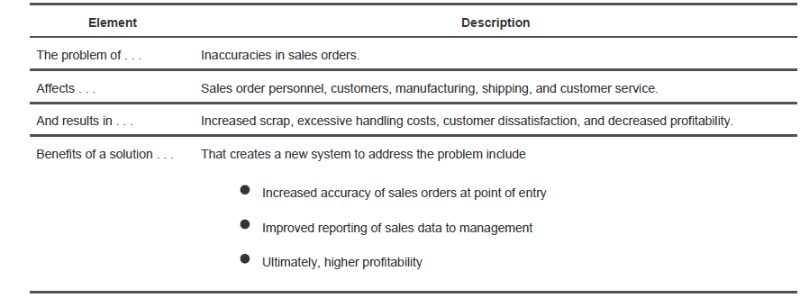
Sales Order Problem Statement

Slide 18
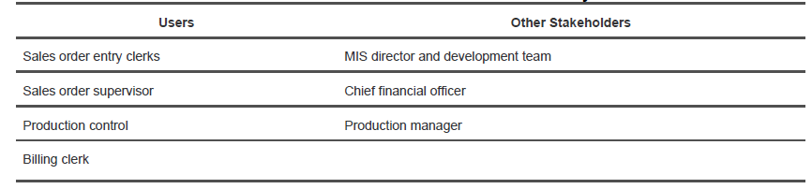
Users and Stakeholders of the New System

Slide 19
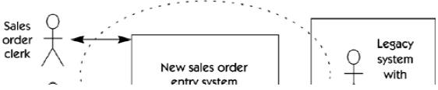
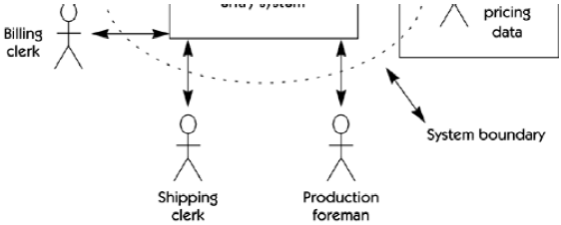
System perspective

Slide 20

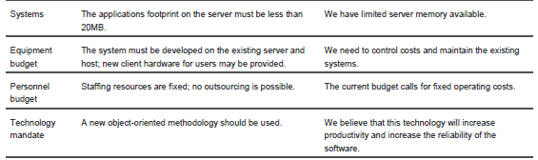
Sources of Constraints and Their Rationale for Sales Order Entry System

